Slide 1
A SCALABLE APPROACH TO VIDEO SUMMARIZATION AND ADAPTATION
Luis Herranz Arribas
Supervisor: Dr. José M. Martínez Sánchez
Video Processing and Understanding Lab
Universidad Autónoma de Madrid

Slide 2
Outline
Introduction
Integrated summarization and adaptation using scalable video coding
Scalable summaries
Applications
Conclusions

Slide 3
INTRODUCTION
Application context and related research areas
Motivation

Slide 4
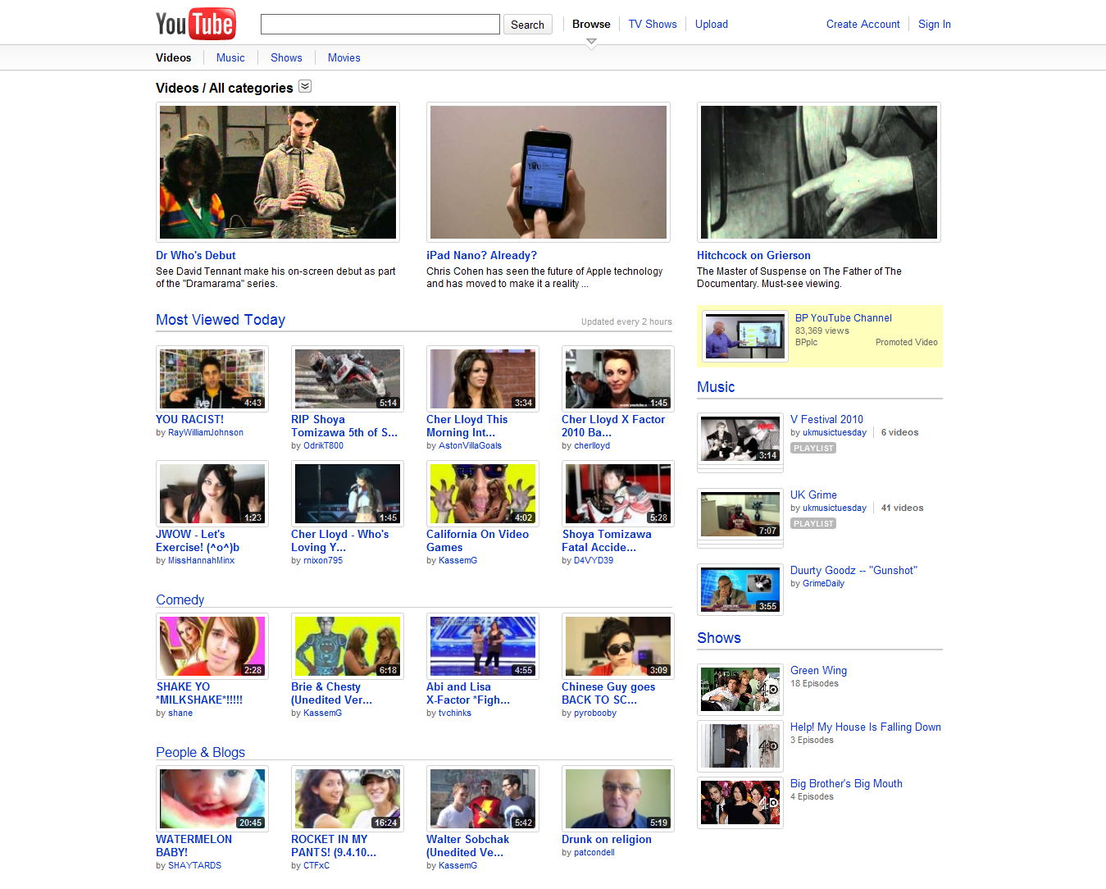
Context: browsing and retrieval
Challenges in video browsing and retrieval
  Huge amount of video content
  Time consuming: each video can last several minutes, even hours
Common solution
  Use abstract (summaries)
  Less information, but much
  faster browsing
Abstracting visual information
  VIDEO SUMMARIZATION
INTRODUCTION

Slide 5
Video summarization
Objective
  Provide the user with a compact representation of the video content (a quick glance of what happens in the sequence)
Requirements
  Should preserve those parts more “semantically” relevant and discard those less informative or redundant (SEMANTIC COVERAGE)
  Compact format; easily and rapidly browsable (COMPACTNESS)
  Appealing and visually pleasant (VISUAL PLEASANTNESS)
Requires analysis of the content
  Previous research works focused on analysis [Kang 2002, Truong 2007]
    Optimization based, clustering, camera motion, highlights, visual attention…
    Low level audiovisual features, high level semantic analysis
    Generic vs domain-dependent (sports, news, movies, home video)
Introduction

Slide 6
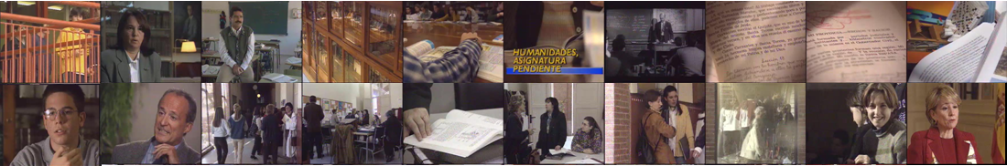
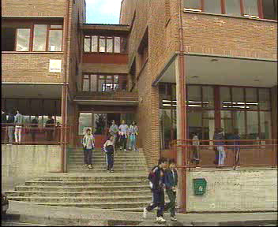
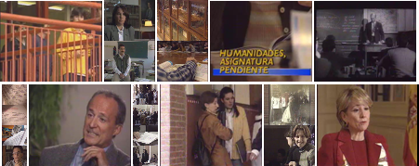
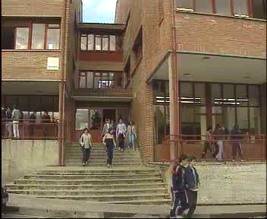
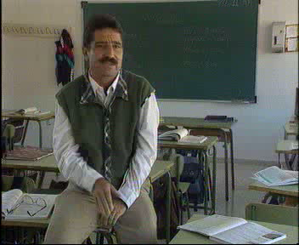
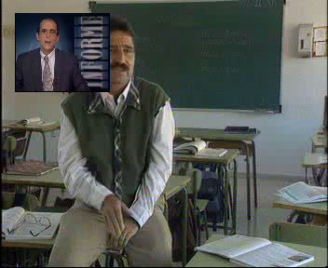
Modalities of video summaries
Pictorial summaries
Storyboard
Comic-like
Sequence-based summaries
Fast forward
Video skim
Composite summary
COMPACTNESS(LENGTH) vs semantic COVERAGE(LENGTH) vs visual PLEASANTNESS(LENGTH)
COMPACTNESS vs semantic COVERAGE vs visual PLEASANTNESS
Introduction
Notes:
Duration 17m14s Summaries 40s
Instead of focusing on the analysis we focus on the ROLE of the LENGTH in video summarization
Resaltar trade-off between compactness (length) and amount of information. Mencionar que algunos son más comodos de ver (visual pleasantness) vs amount of information
Objectives
Reduce browsing time: compact summaries
The more compact, the more items can be shown in the same area/interval
Semantic coverage: include enough representative information
Often it is impossible to optimize both objectives
Trade-off between compactness (browsing time) and semantic coverage

Slide 7



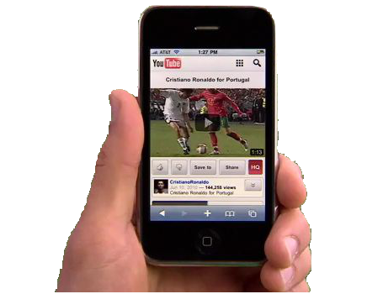
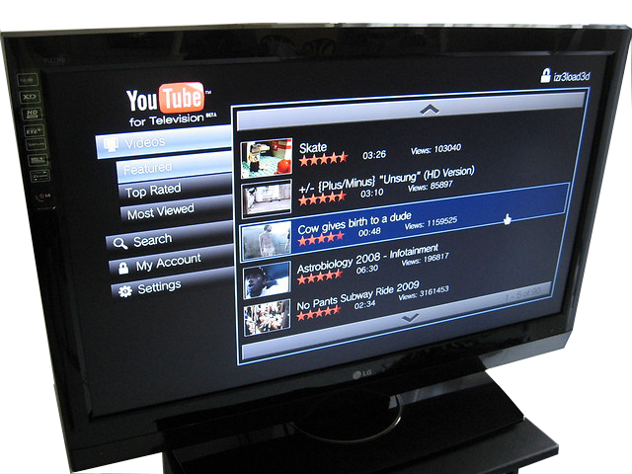

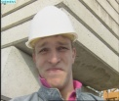




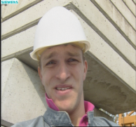

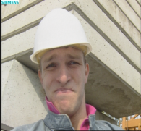

Context: usage environment
Heterogeneous devices
  PC, mobile, TV, iPhone, PDA, …
Multiple access networks
  ADSL, cable, UMTS, WiFi, …
Many ways to access the same video content
  e.g. YouTube (again)
Challenge
  How to provide each user with
  an adequate version, according
  to his/her usage environment
  VIDEO ADAPTATION
Introduction

Slide 8
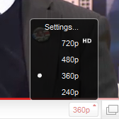
Video adaptation
Alternative approaches
  VARIATIONS: pre-store multiple versions with different
  sets of parameters [MPEG-7 MDS 2001, van Beek et al. 2003]
    Not very flexible and requires more storage space
  TRANSCODING: decoding, adaptation and re-encoding
  [Wu 2001, Xin 2005]
    Flexible, but computationally demanding
  SCALABLE CODING: a basic version is enhanced with additional layers [MPEG-2 1994, Ohm 1994, Li 2001, Schwarz 2007]
    Bitstream SCALABILITY: by removing certain parts of the bitstream, a valid version can still be decoded, with different characteristics
    Multiple versions, embedded in the same bitstream
    Standard: MPEG-4 SVC (Scalable extension of H.264/MPEG-4 AVC)
      Temporal, spatial and quality (PSNR) scalabilities
    Adaptation mechanism: bitstream extraction
Content-based (or semantic) adaptation [Chang and Vetro 2005]
  Uses some level of understanding for enhanced adaptation
  Summarization can be seen as a content-based (structural) adaptation
(eg. YouTube)
SIMPLE and EFFICIENT method!
Introduction

Slide 9
Motivation: scalability and summarization
Integrated summarization and adaptation
  Summaries are generated using transcoding (decoding, frame selection and re-encoding)
    Demanding and time consuming. High processing delay
    Is it possible to use scalable bitstreams and extraction for that?
  Video summaries must be also adapted to the usage environment
    Can we integrate summarization and adaptation?
Scalability
  Length is the main property of a summary
  Adaptation of video summaries
    Number of images/frames, duration, file size, …
    Users/adaptation engines can decide which length prefer
  Can we create a scalable representation of a video summary?
Introduction
Notes:
Following these similarities between summarization and adaptation…

Slide 10
Additional motivation: efficient analysis
Analysis time
  Summarization methods are not fast enough with high resolution videos
    How can we make the summarization algorithm more efficient?
  Some applications require low delay in the response
    How can we reduce the processing delay?
    Is it possible to use scalable bitstreams and extraction to generate summaries?
    Can we integrate summarization and adaptation?
    Can we create a scalable representation of a video summary?
Introduction

Slide 11
Integrated summarization and adaptation using SVC
Using bitstream extraction to generate summaries
Integrated summarization and adaptation

Slide 12
Semantic use of bitstream extraction
Related work
  Scalable coding [MPEG-2 1994, Ohm 1994, Li 2001, Schwarz 2007]
  Bitstream description languages (XML-based adaptation)
    MPEG-21 DIA and BSDL [ITU/ISO 2003, Vetro 2004, Devillers et al. 2005]
  Bitstream customization in the context of (semantic) adaptation
    Motion energy-based frame dropping for H.264/AVC [Gang 2004]
    Shot based adaptation using MPEG-21 BSDL and metadata [DeBruyne et al. 2007]
    ROI-based adaptation [Kim et al. 2006, DeSchriver et al. 2007, Grois et al. 2010]
Proposal
  Separate explicitly analysis and generation in video summarization
  Use of bitstream extraction in the generation stage
    H.264/AVC (and also MPEG-1/2)
  Summarization model to represent the summaries
Integrated summarization and adaptation. bitstream extraction and summaries

Slide 13
Proposed framework for summarization
Conventional framework
  PIXEL oriented (uncompressed frames)
  Generation by TRANSCODING
  Unit for analysis and generation: FRAME
Proposed framework (embedded summaries)
  CODING oriented
  Generation by EXTRACTION
  Unit for analysis and generation: SUMMARIZATION UNIT (e.g. GOP)
Proposed representation model: SUMMARIZATION CURVE
  For each summarization unit (SU):
    Temporal level included (0,…,T)
    Level -1 means SU skipped in the summary
Integrated summarization and adaptation. bitstream extraction and summaries

Slide 14
Summarization units
Example: H.264 hierarchical B frames , GOP 8 frames (4 levels)
  Limitation: precision to select an arbitrary frame: 8 frames (GOP size)
    However, not important in practice if the analysis is designed properly
Closed GOPs
(IDR, non-overlapped)
Integrated summarization and adaptation. bitstream extraction and summaries

Slide 15
Summarization curves and modalities
Example: H.264 hierarchical B frames , GOP 8 frames (4 levels)
MPEG-1/MPEG-2/MPEG-4
  Two levels: I frame (level 0) and full GOP (level 1)
  Model still valid for storyboards and skims (full GOP)
Integrated summarization and adaptation. bitstream extraction and summaries

Slide 16
Transcoding vs extraction: comparison
Extraction compared to transcoding
  Simpler
  No re-quantization
Transcoding
Extraction
Integrated summarization and adaptation. bitstream extraction and summaries

Slide 17
Transcoding vs extraction. Efficiency and quality
Efficiency
Quality (PSNR)
Extraction
outperforms
transcoding
Integrated summarization and adaptation. bitstream extraction and summaries

Slide 18
Including adaptation
Scalable adaptation as optimization problem [Mukherjee 2005]:
for each instant n find OP_{n}*=(d_{n}*,t _{n}*,q_{n}*) maximizing utility(AAU_{n}*)
subject to
frame_width (d_{n}) ≤display_width
frame_height (d_{n}) ≤ display_height
frame_rate(t_{n}) ≤ display_frame_rate
bitsize(AAU_{n}*)≤ available_bits(n)
t_{n}≤ tlevel(n)
Proposed approach to include summarization in this problem
  Summarization as a semantic constraint (on temporal axis)
  Summarization curve tlevel(m) as the additional constraint
    We use tlevel(n), which is tlevel(m) applied at frame level
Instead of a utility measure, the JSVM (SVC reference software) uses a prioritization approach
Adaptation coordinates
Utility/quality measure
Constraints
(terminal, network)
Adapted Access Unit
Summarization constraint
Integrated summarization and adaptation. Summarization and adaptation using SVC

Slide 19
Transcoding vs extraction. Efficiency
2 spatial (4CIF, CIF), 6 temporal (30,15,…) and 2 quality layers
4CIF@30 → 4CIF@30
4CIF@30 → CIF@15
Extraction
is faster
Integrated summarization and adaptation. Summarization and adaptation using SVC

Slide 20
Transcoding vs extraction. Quality (PSNR)
4CIF@30 → 4CIF@30
4CIF@30 → CIF@15
Single layer (AVC) extraction has the best R-D performance
Extraction with multiples layers has some LOSS of quality:
coding penalty due to layered coding
Integrated summarization and adaptation. Summarization and adaptation using SVC

Slide 21
Scalable summaries
Scalable storyboards and video skims
Scalable comic-like summaries

Slide 22
Multi-scale summaries
Objective: summaries with different lengths (scales)
Related work: hierarchical summarization [Zhu 2003,2004; Benini 2006]
  Few scales and hierarchical navigation
Multi-scale summaries: solutions using conventional approaches
  Store multiple summaries (~VARIATIONS)
    Problem: slow and requires significant storage space
  Run on-demand the summarization algorithm for the target length/scale
    Slow and demanding. Two bottlenecks: analysis and generation
Proposed approach: (fine granularity) scalable summaries
  Scalable representation
    Each scale is a subset of the next one
  Compact description: ranked list
  Requirement: efficient generation (bitstream extraction)
Scalable summaries
Notes:
Store multiple summaries
Few scales
Run on-demand the summarization algorithm for the target length/scale
Time and resource consuming
Requirement: efficient generation
In order to make the most of the scalable representation
If the bottleneck is the generation, a scalable representation is not necessary
Bitstream extraction

Slide 23
Analysis algorithm
Proposed method
  GOP based framework (I frames for analysis)
  Shot detection and feature extraction (MPEG-7 color layout)
  Shot-based keyframe sampling
  Clustering: cover main semantics
    Grouping similar keyframes
    Hierarchical clustering
  Ranking and iterative growing: cope with different lengths gradually
Analysis
(GOP level)
(Shot level)
(Sequence level)
Shot change
detection
Candidates
sampling
Feature
extraction
Clustering
Keyframes/
segments ranking
Scalable summaries. Scalable storyboards and video skims
Notes:
No es lo mismo un resumen corto (sacrificar información), que un resumen medio/largo

Slide 24
GOP ranking
Motivation
  Balance coverage and pleasantness depending on the length
  Different approaches depending on the target length
    Short: few frames to represent many semantic elements (focus mainly on coverage)
    Longer: more frames to represent the same concepts, so maybe the summary could be more pleasant (balance coverage and pleasantness)
Approach:
  Tackle both cases separately, but in a gradual manner (ITERATIVE GROWING)
  Algorithm: ITERATIVE GOP RANKING
    Three stages: cluster, shot and residual ranking
Scalable summaries. Scalable storyboards and video skims
Notes:
Different approaches depending on the type of summary
Image storyboard (few frames): mainly semantic coverage
Video skim (many frames): coverage but also avoiding unpleasant temporal artifacts

Slide 25
Cluster level ranking
Score score(c_{i}) : combination of two different scores
  Duration score: relative duration
  Distance score: distance of the keyframes to the previously selected keyframes (i.e. summary of scale q-1). It is a CONDITIONAL score
Example of ranking
  IMPORTANT: scores change in each iteration/scale
Score
Clusters
GOP 0
GOP 1
GOP 2
GOP 3
GOP 4
GOP 5
GOP 6
GOP 7
Ranked list
(summaries)
GOP 2
GOP 3
GOP 7
GOP 1
GOP 0
GOP 6
GOP 4
GOP 5
Scalable summaries. Scalable storyboards and video skims

Slide 26


Example: scalable storyboard
Example (α_{cluster}=0.5)
  Keyframes in temporal order
  Keyframes in ranked order
Scalable summaries. Scalable storyboards and video skims

Slide 27
Overview
Analysis
Input bitstream
Bitstream parsing
Shot change detction
Frame sampling and feature extraction
Clustering
Ranking
0
1
2
3
4
Ranked list
3
0
4
2
1
Generation
Keyframes/segmentsselection
Bitstream extractor
Output bitstream
(summary)
Length=2
0
3
Scalable summaries. Scalable storyboards and video skims

Slide 28



Example: scalable storyboard
1 keyframe
2 keyframe
6 keyframe
10 keyframe
22 keyframe
Scalable summaries. Scalable storyboards and video skims

Slide 29
Evaluation
User study
  Multiscale evaluation: additional difficulties
    Number of experiments multiplied
    by the number of scales
    Other issues (e.g. trial order, biases)
  Experimental setup (4 dimensions)
    3 sequences x 3 scales x 2 modalities
    x 2 algorithms. 18 assessors
    54 tests/assessor in total
  In general, scalable method was preferred
  to the baseline (except for news)
Efficiency. Examples from experimental results:
  GOP length: 15 frames
  27 min MPEG-1 352x240@29.97. Skim 16.5 sec (1%) in 5.6 sec (8700 fps)
  30 min MPEG-2 720x480@29.97. Skim 18 sec (1%) in 14.2 sec (3400 fps)
Scalable summaries. Scalable storyboards and video skims

Slide 30
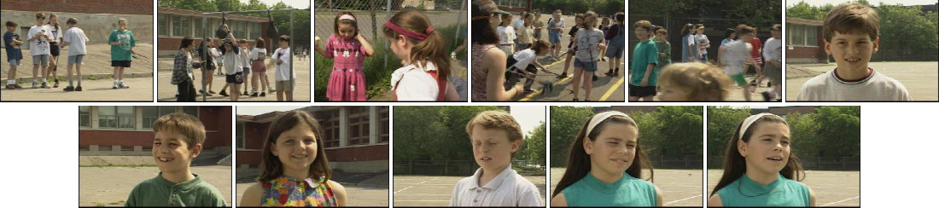
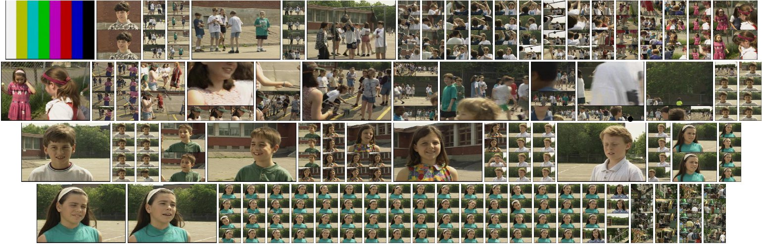
Scalable comic-like summaries
Lowest scale: storyboard
  Compact representation
  Basic coverage
Highest scale: overdetailed comic-like summary
  Small images provide additional information about temporal events
  Useful if a more exhaustive coverage is required
Proposal: intermediate scales (scalable summary)
Scalable summaries. Scalable comic-like summaries

Slide 31
Comic-like summaries
Panels templates and relative area (e.g. height=4)
Keyframes + cost (score)
  Cost represents the EXPECTED AREA in the layout
Layout: sequence of panels containing the keyframes
Ω =
(1,1,1,1)
(2,2)
(2,1,1,1,1)
(1,1,2,1,1)
(1,1,1,1,2)
(3,1,1,1)
(1,1,1,3)
(4)
LAYOUT ERROR
=
Σ(C – Ω²) ²
=
379.4
C =
13.03
0.16
2.17
0.89
10.09
5.39
0.69
0.16
7.28
0.62
Ω² =
16
1
1
1
9
16
4
4
4
4
Scalable summaries. Scalable comic-like summaries

Slide 32
Comic-like summaries
Exhaustive search
  Combinatorial problem. Unfeasible after few tens of frames
    N=10, 1287 combinations
    N=20, 950227 combinations
    N=22, 3422186 combinations
Related work: approximate solutions (not optimal but efficient)
  [Yeung 1998], [Uchihashi 1999], dynamic programming [Calic 2007]
error = 379.4
error = 601.2
...
1287
combinations
error = 1427.5
Scalable summaries. Scalable comic-like summaries

Slide 33
Method 1: independent scales
Approach
  Sample the keyframe set in steps of N keyframes (scale step)
  And compute the layout for the sampled subset
Architecture
  Estimation of cost (expected area): based on clustering [Calic 2007b]
  Sampling: cost based. Top M keyframes
  Layout: independent for each scale. Dynamic programming
Satisfactory when only one scale is shown (e.g. adaptation)
Scalable summaries. Scalable comic-like summaries

Slide 34
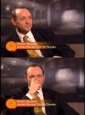
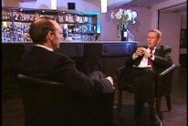
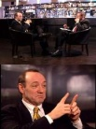

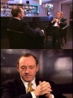


Layout disturbance
In some applications, the user browses several scales
  Progressive visualization, browsing, interactive navigation
Transition between scales
  Displacement of panels/images
  Changes of the size of the images
  Very uncomfortable for the user
    Especially when changes are spread all throughout the layout
Scale q-1
New images = 4
Images changed = 7
Panels changed
3 new
2 removed
Scale q
Scalable summaries. Scalable comic-like summaries

Slide 35
Method 2: anchor based approach
Objective: reduce the layout disturbance
  Confining the change of panels/images to small regions
Anchor images
  Keyframes with maximum cost must not change their size (biggest)
  Layout is only recomputed between anchor images
Temporally constrained sampling
  Select keyframes based on high cost but also within segments with a limited length
Evaluation
  Length of the segment with changes is
  reduced
  User study
    In general, users preferred anchor method
    User interface is also very important
Scalable summaries. Scalable comic-like summaries
Notes:
Fits into the idea of comic-like as enhanced storyboard

Slide 36
Applications
Resizable storyboards
Multichannel TV summaries
Composite summaries

Slide 37
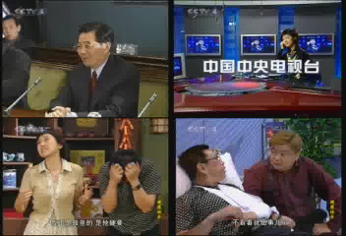
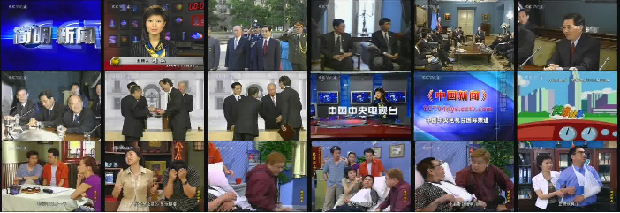
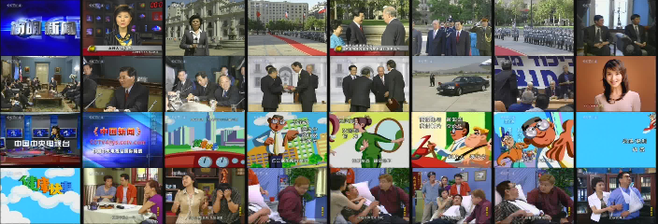
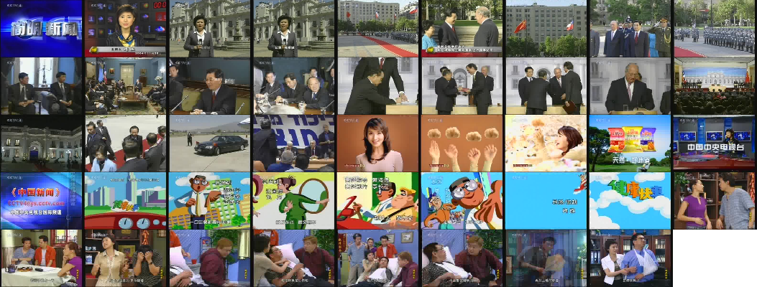
Resizable storyboards
The area required by a storyboard depends on
  Number of images
  Size of each image
Using scalable storyboards, the summary can be easily adjusted to the available area
18 images
(size 1)
32 images
(size 0.75)
44 images
(size 1)
4 images
(size 1.5)
Applications. Resizable storyboards
Notes:
Ranked lists: low disturbance (only new images are changed)

Slide 38
Multichannel summarization of TV broadcast
Broadcasting scenario is very demanding
  Live, high bitrates
  Multiple channels, i.e. multiple summaries
Proposed method
  Scalable storyboards (efficient algorithm)
  On-line architecture (processing is performed in advance during the reception)
  Experimental test: 4 channels 720x480 pixels 30 fps
    Summary of last 30 minutes: 0.3 sec (30.6 sec, off-line architecture)
On-line
Off-line
Applications. Multichannel summarization of TV broadcast
Notes:
Demo: file:///D:/work/Documentos/Doctorado/Tesis/presentacion/demos/multichannel/demo.html
Experiments performed in an Intel Xeon@2.83 Ghz Quad 24 Gb

Slide 39


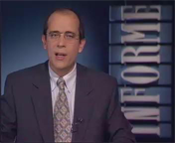
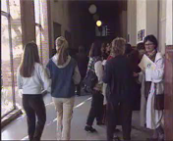



Composite summaries of news videos
Anchorperson + news story
  Anchorperson introduces the news story, i.e. gives an audio SUMMARY
Summary: anchorperson (with audio) + news story summary
  Related work: [Valdés 2010] (transcoding and server-side composition)
  Proposed: EXTRACTION (using scalability) + CLIENT-SIDE COMPOSITION
Spatial
adaptation
Length
adaptation
Composition
(spatial scalability)
(length scalability)
Applications. Composite summaries
Notes:
http://sherpa.ii.uam.es/composite_summaries_eval/demo_interface_vs.html

Slide 40
Conclusions
Summary of contributions
Conclusions

Slide 41
Main contributions
Integrated summarization and adaptation
  Framework and representation model for efficient generation of summaries using bitstream extraction
  Joint summarization-adaptation framework using SVC
Scalable summaries
  Concept, requirements, suitable description (ranked list) and framework
  Analysis algorithm to generate scalable storyboards and video skims
    Efficient analysis
  Concept of scalable comic-like summaries, method and architecture to obtain them
    Layout disturbance and a heuristic sampling/layout method
Novel applications of the proposed methods
  Resizable interfaces using scalable storyboards, composite summaries, efficient summarization of multichannel TV broadcasts
Conclusions

Slide 42
Conclusions
SUMMARIZATION vs ADAPTATION
  Similarities between adaptation of video and adaptation of summaries
  Summarization as a semantic adaptation constraint
SCALABLE BITSTREAMS as core representations
  From a single scalable bitstream we can extract
    Multiple summaries (different modalities and lengths)
    Adapted versions of videos and summaries
BITSTREAM EXTRACTION as the only tool
  Simple, low complexity and fast adaptation
  Multiple applications in personalization, interactivity and user interfaces
Efficient analysis and low delay may be also important in some applications
Conclusions

Slide 43
Publications
Generation of video summaries by bitstream extraction
  L. Herranz, J.M. Martínez, "On the use of hierarchical prediction structures for efficient summary generation of H.264/AVC bitstreams", Signal Processing: Image Communication, vol. 24, no. 8, pp. 615-629, September 2009
  L. Herranz, J.M. Martínez, "On the advantages of the use of bitstream extraction for video summary generation", International Conference on Multimedia Modeling (MMM10), Lecture Notes on Computer Science, vol 5916, pp. 755-760, Springer Verlag, Chongqing, China, January 2010
Integrated summarization and adaptation
  L. Herranz, "A framework for online semantic adaptation of scalable video", Proc. IEEE International Workshop on Semantic Media Adaptation and Personalization (SMAP06), pp. 13-18, Athens, Greece, December 2006
  L. Herranz, "Integrating semantic analysis and scalable video coding for efficient content-based adaptation", Multimedia Systems, vol. 13, no. 2, pp. 103-118, August 2007
  L. Herranz, J.M. Martínez, "Use cases of scalable video based summarization within MPEG-21 DIA", International Conference on Semantic and Digital Media Technology (SAMT07), Lecture Notes on Computer Science, vol 4816, pp. 256-259, Springer Verlag, Genoa, Italy, December 2007
Conclusions

Slide 44
Publications
Integrated summarization and adaptation (cont)
  L. Herranz, J.M. Martínez, "Integrated summarization and adaptation using H.264/MPEG-4 SVC", Proc. International Conference on Visual Information Engineering (VIE08), pp. 729-734, Xi'an, China, July 2008
  L. Herranz, J.M. Martínez, "An integrated approach to summarization and adaptation using H.264/MPEG-4 SVC", Signal Processing: Image Communication, vol. 24, no. 6, pp. 499-509, July 2009
  L. Herranz, J.M. Martínez, “Using MPEG Tools in Video Summarization”, The Handbook of MPEG Applications: Standards in Practice, Ed. Marios C. Angelides and Harry Agius, John Wiley & Sons, November 2010
Scalable storyboards and video skims
  L. Herranz, J.M. Martínez, "Generation of scalable summaries based on iterative GOP ranking", Proc. International Conference on Image Processing (ICIP08), pp. 2544-2547, San Diego, California, October 2008
  L. Herranz, J.M. Martínez, "An efficient summarization algorithm based on clustering and bitstream extraction", Proc. International Conference on Multimedia and Expo 2009 (ICME09), pp. 654-657, New York, New York, July 2009
  L. Herranz, J.M. Martínez, "A framework for scalable summarization”, IEEE Transactions on Circuits and Systems for Video Technology, vol. 20, no. 9, pp. 1265-1270, September 2010
Conclusions

Slide 45
Thank you

